Slide 1

Town of Ingersoll
2023 Operating Budget Presentation
March 6, 2023

Slide 2
Agenda
2023 Budget Process
Operating Budget Highlights
Property Tax Impact
Community Groups Grant Applications
Departmental Highlights
Reserves and Reserve Funds
Debt

Slide 3
2023 Budget Process
Fall 2022
Departmental Budget Submissions and Reviews
Jan 16
2023
Presentation of 2023 Draft Operating and Capital Budgets
Feb 16 2023
Review of 2023 Operating Budget
Jan 30 2023
Review and Approval of 2023 Capital Budget
March 6,
2023
Approval of 2023 Operating Budget

Slide 4
Budget Priorities
No Reduction in Services
Minimize Tax Rate Impact, manage affordability
Align with Council Strategic Priorities
No New Debt
Manage Reserves and Reserve Funds
Invest in Infrastructure, closing infrastructure gap
Risk Mitigation (large tax appeals, loss of assessment)

Slide 5
Challenges
Rising inflation
Supply chain disruptions
Competitive labour market
Continuing COVID-19 pandemic
External challenges posed by changing provincial legislation (Bill 23)
Large tax appeals, loss of assessment

Slide 6
Summary 2023 Budget
$17.56 M Operating Budget
$3.4 M Transfers to Reserves
Since the last budget submission presented on January 16, 2023 staff has made adjustments to the Operating Budget in the amount of $9,592.

Slide 7
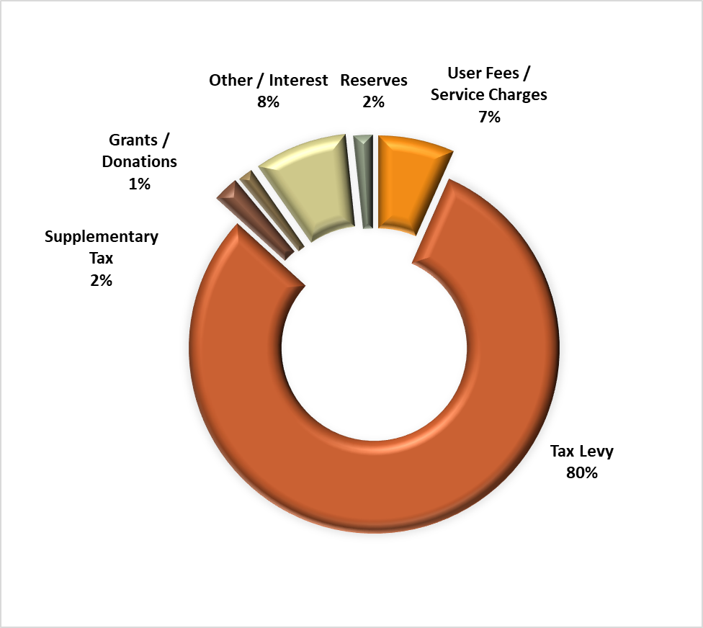
Operating Budget Revenue Sources
2023 Tax Levy $16.95 M
(2022: $16.46M)
Levy Increase
$506,908 or 3.08%
$21.12M

Slide 8
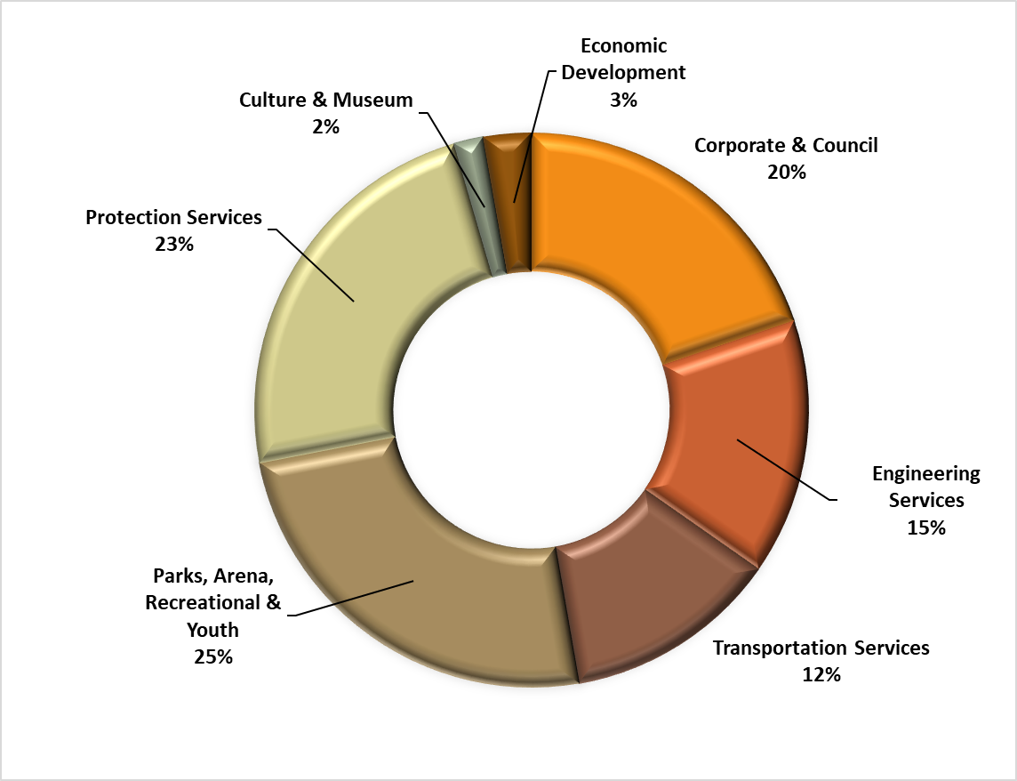
Where Tax Dollars Are Spent?

Slide 9
Where Tax Dollars Are Spent?

Slide 10
Tax Impact
Tax Levy Increase:
Growth 1.25%
Existing Ratepayers 1.83%
$222,000
$222,000
Note: The Province postponed the 2020 Assessment Update. Property Assessment Values for the 2023 taxation year will be based on the January 1, 2016 valuation date. This means the 2022CVA’s will be the same as the 2022 CVA’s.

Slide 11
Operating Budget Highlights
High investment income: high interest rates
$3.5 million in transfers to reserves to fund Town's future capital needs, and strengthen our financial position
$300K in continued funding for the Multi Use Recreational Facility
Increased transfers to Reserves & Reserve Funds ($390K)
3.5% cost of living adjustment, step increases
Enhanced By-Law enforcement ($50K)
Escalating Insurance costs ($100K)
Savings in professional fees (landfill consulting fees) $30K
Reduction in OMPF Funding ($26K)
OPP Contract Savings ($210K)

Slide 12
Special Projects
Corporate
Tax Bills Email Module ($7K)
Beanworks Accounts Payable Automation Software ($12K)
Downtown Parking Review ($50K)
Development Charges Study & By-Law ($35K)
Protection Services (Building Inspections, By-law, Fire, Police)
By-law enforcement ($50K)
Finish Building Fees Study ($2K)

Slide 13
Special Projects
Recreational / Cultural Services
Create Museum video content to promote tourism and capture history ($10K)
GE Diamond -Replace foul polls ($6K)
VPCC - Upgrade vanities and partitions ($5K)
VPCC - Replace carpets in offices ($5K)

Slide 14
New Full Time Positions
Deputy Treasurer (start date June 2023)
Public Works Operator (start date as soon as possible)
VPCC Admin Staff Manager (filled)
VPCC Program Staff Supervisor (filled)
Museum Assistant Curator (start date June 2023)
2 summer students for Public Works

Slide 15
2023 Grant Applications

Slide 16
Departmental Highlights
Budget | 2022 | 2023 | Change 2022 to 2023
Council | $235,155 | $253,605 | $18,450 / 8%
Meetings and conferences up $9.5K: SOMA trip to Asia, $2.5K added to conferences budget
COLA increases for Council ($9K)
Marketing & Promotion Budget:
Registration for charity events (golf tournaments, Chamber of Commerce, etc.) - $4,500
Town Crier - $1,000
Council annual meals allowance - $3,500
Meetings & Conferences
- ROMA , OGRA, AMO, ASUM, trip to Japan

Slide 17
Departmental Highlights
Budget | 2022 | 2023 | Change 2022 to 2023
CAO | $335,445 | $339,690 | $4,245 / 1%
Reduced professional and legal fees ($30K)
$10,000 grant to the Ingersoll Physician Recruitment Committee to support physician recruitment efforts. This requested will be funded from reserves, no impact on the levy

Slide 18
Departmental Highlights
Budget | 2022 | 2023 | Change 2022 to 2023
Clerks | $587,440 | $661,575 | $74,135 / 13%
Paratransit | $42,030 | $43,590 | $1,560 / 4%
Crossing Guards | $80,600 | $66,970 | ($13,630) / 17%
Downtown Parking Review ($50K)
Additional Laserfiche licenses ($7K), Community engagement tool ($6K)
Reduction in COVID-19 related expenses ($50K)
Cost of living increases
Crossing Guards gap analysis was completed in 2022, savings of $8K

Slide 19
Departmental Highlights
Budget | 2022 | 2023 | Change 2022 to 2023
IT | $405,165 | $413,925 | $8,760/ 2%
Cost of living increases
External/Perimeter network penetration testing for Cyber Insurance renewal not required in 2023, savings of $7K
Increase of $7K in BookKing Rec Management Software annual billing and other software annual maintenance fees

Slide 20
Departmental Highlights
Budget | 2022 | 2023 | Change 2022 to 2023
Treasury | $1,025,494 | $460,494 | ($565,000) / 55%
Investment revenue increases ($735K) due to record high interest rates
Cost of living increases for current staff. Added one full time position – Deputy Treasurer (starting July 2023)
Reduction of Ontario Municipal Partnership Fund (OMPF) ($26K).
Rising insurance premiums ($100K)
Increase in transfers to Cemetery Board ($13K)
Increases in health insurance premiums for retirees (in 2022 two retirees added to the retiree pool)
Development Charges Study ($35K). To be funded from Reserve Funds, no impact on the levy

Slide 21
Departmental Highlights
Budget | 2022 | 2023 | Change 2022 to 2023
Tax Adjustments | $900,082 | $971,143 | $71,061 / 8%
Tax Levy | $16,458,372 | $16,832,780 | $374,408 / 2.27%
Reduced supplementary taxes ($105K)
Reduced phase-in refunds to the property owners on annexed lands. Reduced allowance for vacancy rebates ($34K)

Slide 22
Departmental Highlights
Budget | 2022 | 2023 | Change 2022 to 2023
Building Inspections | -- | -- | --
Property Standards | $47,690 | $97,375 | $49,685 / 104%
Town Hall | $167,438 | $160,043 | ($7,395) / 4%
Cost of living increases
By-Law enforcement contract ($50K)

Slide 23
Departmental Highlights
Budget | 2022 | 2023 | Change 2022 to 2023
Fire | $1,195,171 | $1,252,167 | $56,996 / 5%
Fire Facility | $19,904 | $23,505 | $3,601 / 18%
Cost of living increases for full time staff and volunteer firefighters
Increases in uniforms and clothing budget ($20K).
Reduction in training budget, Auto Extraction Courses not required in 2023 ($7K savings).
Increases in vehicle repair, maintenance and fuel costs ($11K).

Slide 24
Departmental Highlights
Budget | 2022 | 2023 | Change 2022 to 2023
OPP | $2,729,174 | $2,525,752 | ($203,422)/ 7%
PSB | $36,585 | $39,414 | $2,829 / 8%
OPP Facility | $13,131 | $9,540 | (3,591) / 27%
OPP Contract reduction due to the cancelation of the enhancement ($209K)
Police Services Board budget has been finalized by the Board

Slide 25
Departmental Highlights
Budget | 2022 | 2023 | Change 2022 to 2023
Engineering | $2,138,380 | $2,203,325 | $64,945 / 3%
Street Lights | $307,300 | $301,500 | ($5,800) / 2%
Cost of living increases for staff
License engineer services ($20K) while filling Town Engineer vacancy
Increased transfers to reserves according to the approved Asset Management Plan ($50K)

Slide 26
Departmental Highlights
Budget | 2022 | 2023 | Change 2022 to 2023
Public Works | $1,857,264 | $2,071,327 | $214,063 / 11%
Added one full time union position and 2 summer students. Cost of living increases.
Increases in the cost of fuel and maintenance. Revised machine rates to include inflationary increases.
Increased transfers to reserves per Asset Management recommendations
Sidewalks winter maintenance contact increase ($10K)
Tree trimming / removal contract increase of $15,000
Inflationary increases to the cost of salt / sand ($11K)

Slide 27
Departmental Highlights
Budget | 2022 | 2023 | Change 2022 to 2023
Parks Admin | $203,181 | $185,300 | ($17,881)/ 9%
Arena | $479,801 | $668,483 | $188,682 / 39%
Parks | $949,421 | $932,450 | ($16,971) / 2%
Seniors Centre | $281,882 | $318,580 | $36,698 / 13%
End of contract - COVID-19 vaccine screeners ($40K savings)
Staff training savings ($11K)
Rising fuel prices
Increased transfers to the MURC reserve based on the 10 yr. capital forecast ($180K)
Increased transfers to reserves for Senior Center based on the facility assessment report ($25K)

Slide 28
Departmental Highlights
Budget | 2022 | 2023 | Change 2022 to 2023
VPCC Admin | $91,366 | $230,782 | $139,416 / 153%
Aquatics | $154,310 | $257,065 | $102,755 / 67%
Fitness & Programs | $301,862 | $379,054 | $77,192 / 26%
VPCC Facility | $658,233 | $610,565 | ($47,668) / 7%
Fully recover from the pandemic and grow community services revenues to pre pandemic levels.
New full time position - Admin Staff Manager. This position was approved by Council through the reorganization of the VPCC structure. Additional part time staff for Aquatics, Fitness and General Programs (equivalent of 1 FTE). Includes wage increases and OMERS for part-time staff.
Upgrade training supplies for the Aquatics and other programs.
Inflationary increases in equipment and building maintains contracts ($28K)

Slide 29
Departmental Highlights
Budget | 2022 | 2023 | Change 2022 to 2023
Fusion Programs | $427,318 | $504,805 | $77,487 / 18%
Fusion Facility | $113,168 | $213,874 | $100,706 / 89%
Reduction in donations budget (United Way)
Cost of living increases
Increased cost of program supplies (art program, groceries for culinary program, sports equipment etc.)
Increase in transfers to reserves as per the Asset Management recommendations ($100K)

Slide 30
Departmental Highlights
Budget | 2022 | 2023 | Change 2022 to 2023
Museum | $200,662 | $293,027 | $92,365/ 46%
Add one full time position - Assistant Curator, cost of living increases, OMERS for part time staff
Special project – video content to promote tourism ($10K)

Slide 31
Departmental Highlights
Budget | 2022 | 2023 | Change 2022 to 2023
Ec. Dev. | $461,380 | $464,675 | $3,295 / 1%
Step and cost of living increases
Decrease provision for Community Improvement grants and incentives
Increase transfers to the Industrial Land reserve fund ($150K)

Slide 32
Reserves & Reserve Funds

Slide 33
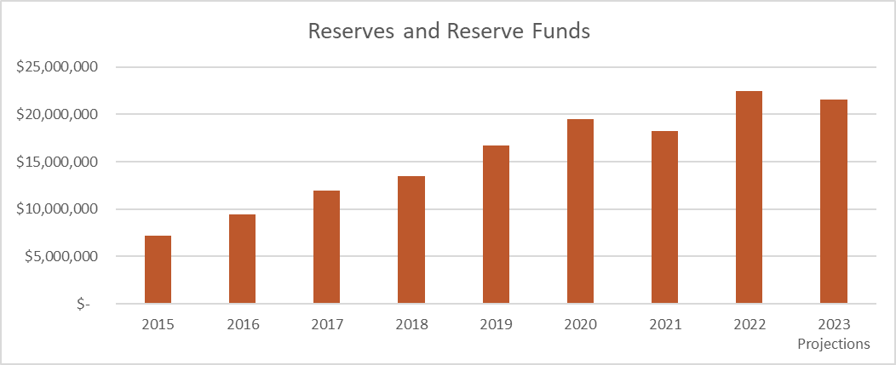
Reserves & Reserve Funds

Slide 34
Debt
Annual repayment limit should not exceed 25% of own source revenues
No new debt is projected for the 2023 fiscal year
Outstanding debt at the end of 2023 - $1,243,394

Slide 35
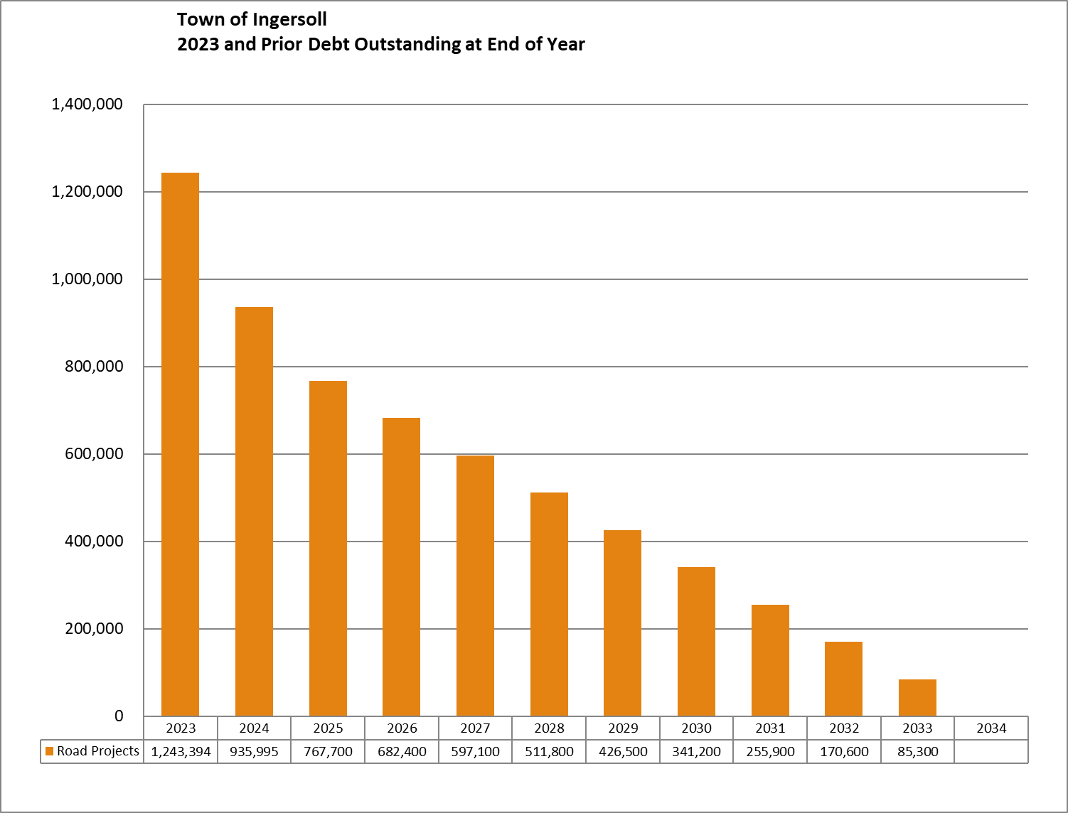
Debt Outstanding at End of Year

Slide 36
Thank you!

